Slide 1
PERSONALIZED MENTAL HEALTH PREDICTION FOR EMPLOYEES
Presented By
Sai Varun Nimmagadda
Shaheen Chirakula
Vishnu Vikas Nallamalli

Slide 2
INTRODUCTION TO THE PROJECT
What is the project about?
This project aims to explore the state of mental health in the tech industry, analyzing factors that influence whether tech employees seek mental health treatment. The technology industry, known for its high-pressure work environments, long working hours, and competitive culture, is increasingly facing scrutiny for its impact on employee well-being.
Why was this project chosen?
This project was chosen because of its relevance to today’s workplace challenges, particularly in the tech sector where employees experience high levels of stress. With publicly available data and strong potential for real-world impact, this project is both meaningful and feasible.

Slide 3
DATASET

Slide 4
WHAT KIND OF DATA IS STUDIED?
The project uses the 'Mental Health in Tech' survey dataset, which captures information on:
- Demographics (age, gender, country).
- Workplace conditions (remote work, company size, tech vs non-tech employer).
- Employer policies (mental health benefits, wellness programs, anonymity).
- Personal history (family history, previous diagnosis, current treatment).
- Perceptions and stigma (fear of consequences, comfort discussing issues).
How large is the dataset?
The dataset contains 3269 rows responses and 85 columns with data from 2016-2021
What is the source of the dataset?
The dataset comes from an open survey conducted to understand mental health challenges faced by employees in the technology sector. It has also been used in public data science competitions.

Slide 5
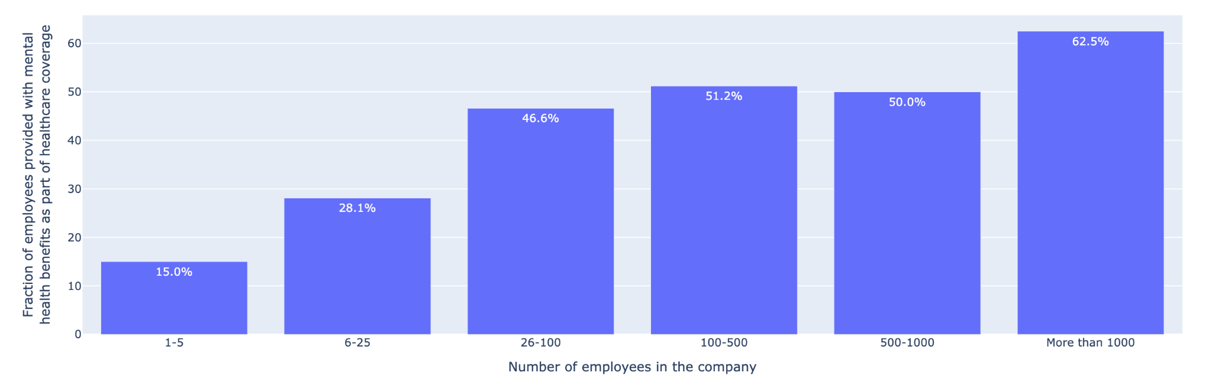
EDA-Data Visualization
Fraction of employees in companies of different sizes provided with mental health benefits as a part of health coverage.

Slide 6
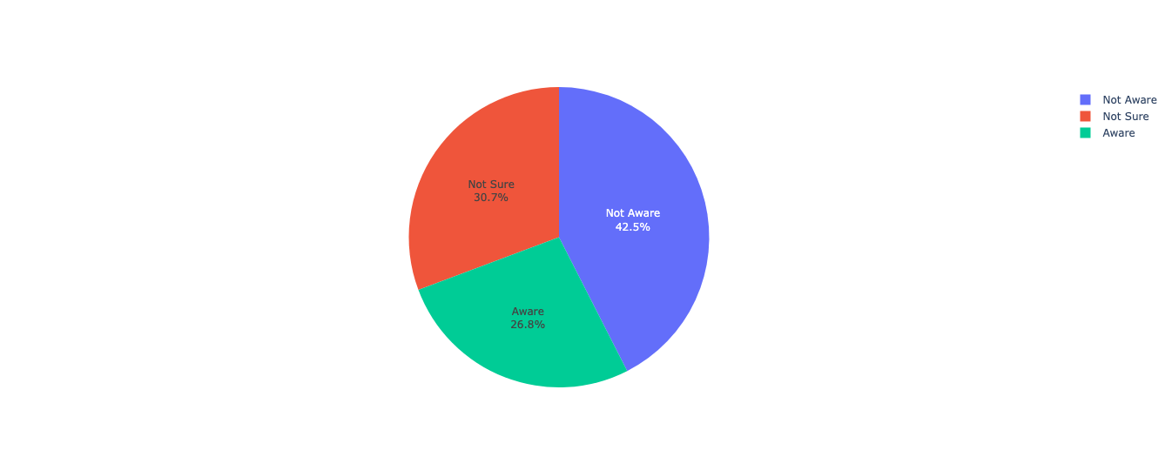
EDA-Data Visualization
Employees’ awareness of mental health care options available under their employer- provided coverage.

Slide 7
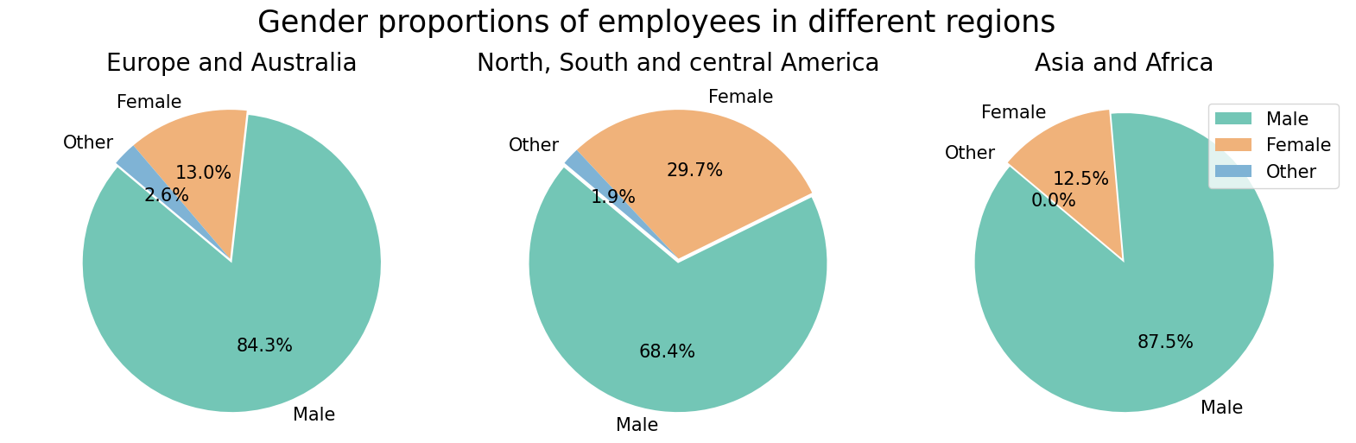
EDA-Data Visualization

Slide 8
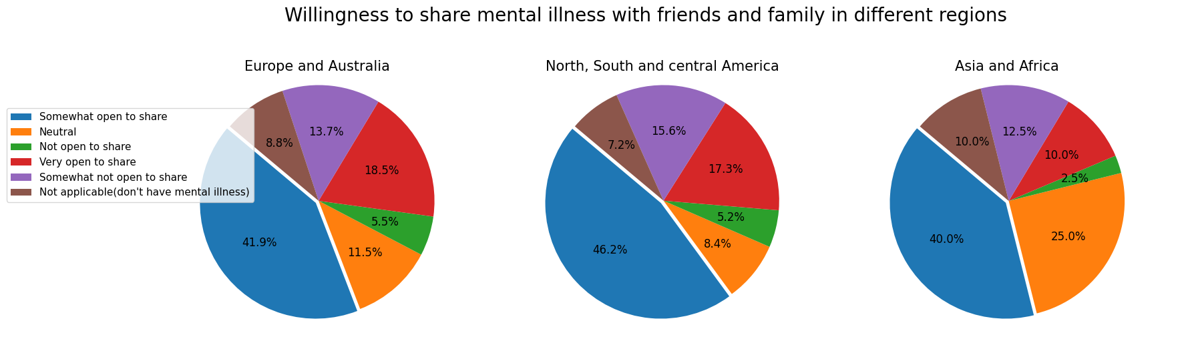
EDA-Data Visualization

Slide 9
Predicting mental health diagnosis
In order to predict the employees' possibility of being diagnosed with a mental health issue, different prediction models were implemented. The predictions were obtained by classifying the employees into 2 classes namely: ‘diagnosed for mental health issue by a medical professional’ and ‘not diagnosed for mental health issue by a medical professional’. The classification was done based on the target variable, ‘Have you been diagnosed with a mental health condition by a medical professional?’. 70% of the data set was used for training and 30% for testing. Multiple prediction models were implemented to obtain the model providing high accuracy predictions.
The following classifiers were implemented:
K neighbors classifier
Logistic regression
Decision tree classifier
Random forest classifier
ADAboost classifier
XGB Classifier
Gradient boosting classifier

Slide 10
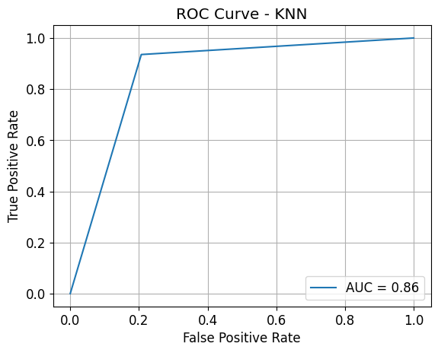
KNN
Mean Absolute Error: 0.13662790697674418
Mean Squared Error: 0.13662790697674418
Root Mean Squared Error: 0.3696321238430775
Accuracy = 86.34%
Precision = 0.87
Recall = 0.86
F1 Score = 0.86
precision recall f1-score support
0 0.93 0.79 0.85 174
1 0.82 0.94 0.87 170
accuracy 0.86 344
macro avg 0.87 0.86 0.86 344
weighted avg 0.87 0.86 0.86 344

Slide 11
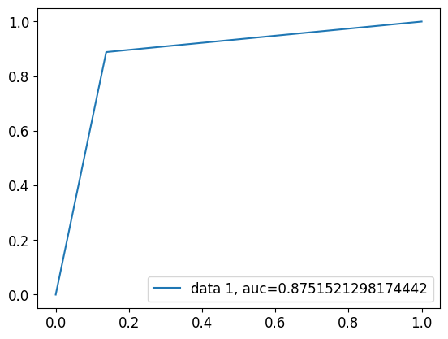
Logistic Regression
Mean Absolute Error: 0.125
Mean Squared Error: 0.125
Root Mean Squared Error: 0.3535533905932738
accuracy = 87.5
p = 0.8752155536770921
r = 0.8751521298174442
f1 = 0.8749989436768496
precision recall f1-score support
0 0.89 0.86 0.87 174
1 0.86 0.89 0.88 170
accuracy 0.88 344
macro avg 0.88 0.88 0.87 344
weighted avg 0.88 0.88 0.87 344

Slide 12
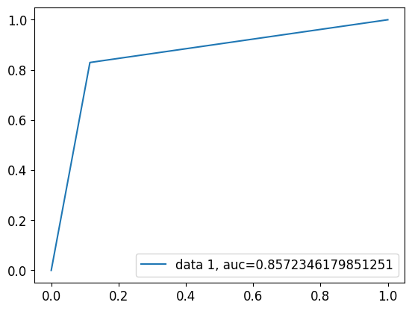
Decision trees
Mean Absolute Error: 0.14244186046511628
Mean Squared Error: 0.14244186046511628
Root Mean Squared Error: 0.37741470621203443
accuracy = 85.75581395348837
p = 0.8586532260801684
r = 0.8572346179851251
f1 = 0.8573544221313903
precision recall f1-score support
0 0.84 0.89 0.86 174
1 0.88 0.83 0.85 170
accuracy 0.86 344
macro avg 0.86 0.86 0.86 344
weighted avg 0.86 0.86 0.86 344

Slide 13
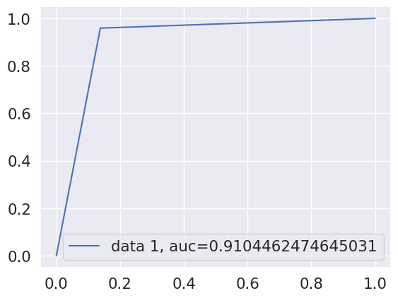
RANDOM FOREST
Mean Absolute Error: 0.09011627906976744
Mean Squared Error: 0.09011627906976744
Root Mean Squared Error: 0.30019373589361825
accuracy = 90.98837209302324
p = 0.9135358833747744
r = 0.910446247464503
f1 = 0.9097548384912877
precision recall f1-score support
0 0.96 0.86 0.91 174
1 0.87 0.96 0.91 170
accuracy 0.91 344
macro avg 0.91 0.91 0.91 344
weighted avg 0.91 0.91 0.91 344

Slide 14
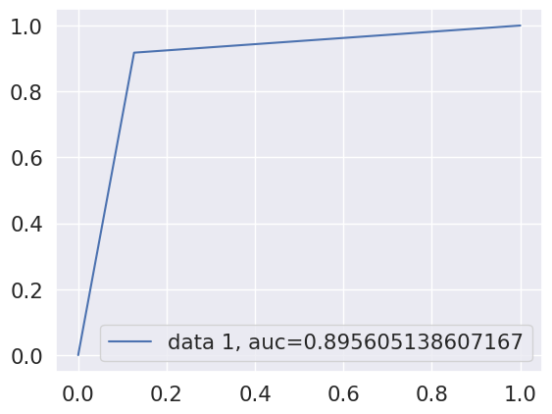
ADABOOST
Mean Absolute Error: 0.10465116279069768
Mean Squared Error: 0.10465116279069768
Root Mean Squared Error: 0.3234983196103153
accuracy = 89.53488372093024
p = 0.896033572492216
r = 0.8956051386071671
f1 = 0.8953346855983773
precision recall f1-score support
0 0.92 0.87 0.89 174
1 0.88 0.92 0.90 170
accuracy 0.90 344
macro avg 0.90 0.90 0.90 344
weighted avg 0.90 0.90 0.90 344

Slide 15
XGBOOST
Mean Absolute Error: 0.09011627906976744
Mean Squared Error: 0.09011627906976744
Root Mean Squared Error: 0.30019373589361825
accuracy = 90.98837209302324
p = 0.9135358833747744
r = 0.910446247464503
f1 = 0.9097548384912877
precision recall f1-score support
0 0.96 0.86 0.91 174
1 0.87 0.96 0.91 170
accuracy 0.91 344
macro avg 0.91 0.91 0.91 344
weighted avg 0.91 0.91 0.91 344

Slide 16
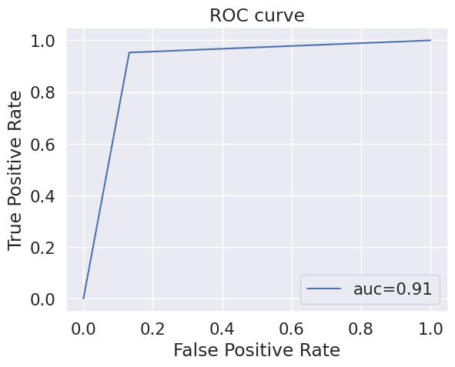
GRADIENT BOOSTING CLASSIFIER
Mean Absolute Error: 0.09011627906976744
Mean Squared Error: 0.09011627906976744
Root Mean Squared Error: 0.30019373589361825
accuracy = 90.98837209302324
p = 0.9126806051334353
r = 0.9103786342123056
f1 = 0.9097914816224675
precision recall f1-score support
0 0.95 0.87 0.91 174
1 0.88 0.95 0.91 170
accuracy 0.91 344
macro avg 0.91 0.91 0.91 344
weighted avg 0.91 0.91 0.91 344

Slide 17
Performance Comparison between Models
Best Model: XGBoost Classifier
• Accuracy: 90.99%
• Precision / Recall / F1: ~91%
• Cross-Validation Score: 89.28% ± 4.26%
• Outperformed all others (KNN, Random Forest, etc.)

Slide 18
THANK YOU

